Slide 1
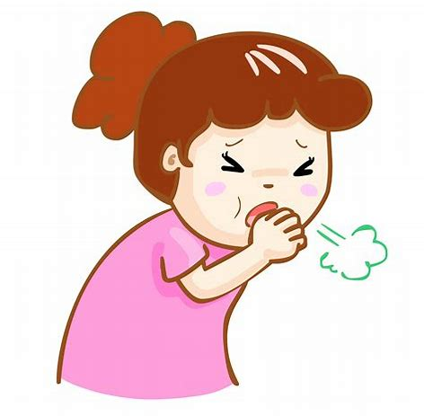
Daily Review
Reminder
Stimulus → Receptor → Control centre → Effector → Response
A reflex action is an involuntary, almost instantaneous movement in response to a stimulus.
Describe the stimulus response model for the cough reflex: when food/dust caught in your trachea causes you to cough.

Slide 2
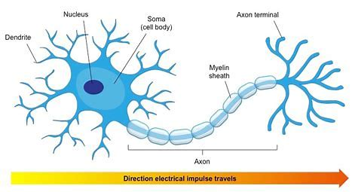
Daily Review
Neurons carry electrical messages, called nerve impulses, from one part of the body to another at very high speed.
Nerve impulses only travel in one direction.
Order the parts of a neuron in order of the nerve impulse.
A Axon
B Synaptic Terminal
C Cell Body
D Dendrite
Does the nerve impulse travel through the myelin sheath?

Slide 3
The Endocrine System
Year 9 Biology

Slide 4
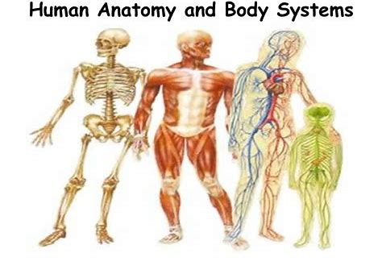
Learning Objectives
CFU
What are we going to learn?
Describe the function of the endocrine system.
Identify target cells of hormones and their effects.
Activate Prior Knowledge
Our body has several organ systems that work together to maintain an optimal level of functioning.
Think, Pair, Share:
List three different systems within the body.

Slide 5
Concept Development
CFU 1
What is the endocrine system composed of?
CFU 2
How do hormones travel around the body?
Endocrine System
The endocrine system is a collection of glands and organs that secrete hormones.
Its function is to maintain the body’s internal environment.
Hormones are secreted into the blood and travel around the body via the circulatory system.
Glands and organs of the endocrine system are located all throughout the body.
The endocrine system acts much slower than the nervous system, however its effects last longer.
CFU 3
Think, Pair, Share: Why do you think the endocrine system is slower than the nervous system?
Vocabulary
Secrete: release

Slide 6
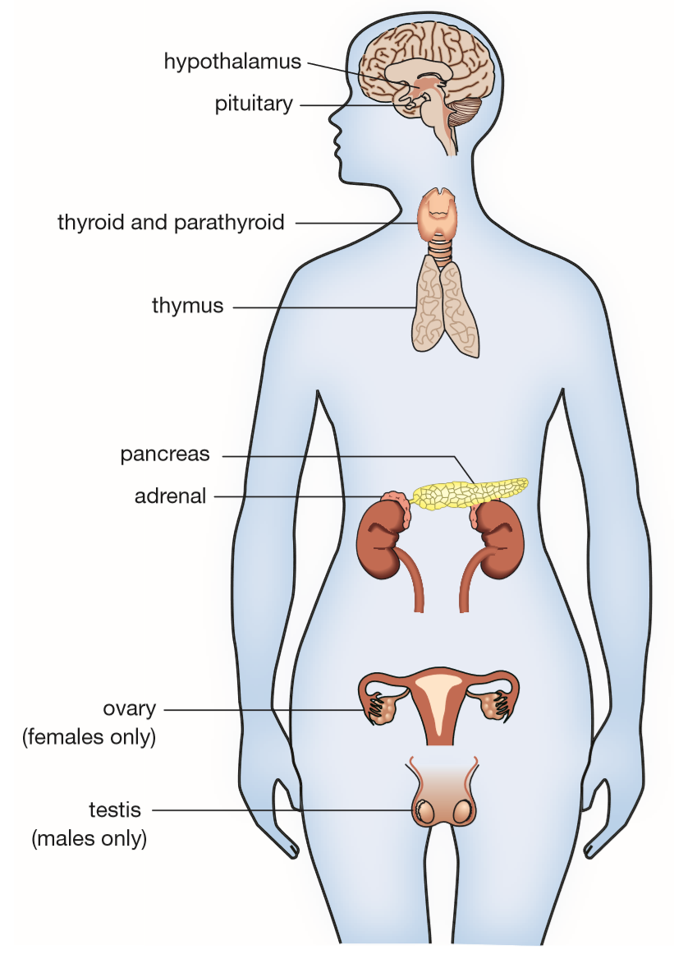
Concept Development
CFU 1
Why are endocrine glands called ductless glands?
CFU 2
Where are hypothalamus and pituitary gland located?
Endocrine Glands
There are several glands that make up the endocrine system.
They are referred to as ductless glands because they secrete hormones straight into the bloodstream.
Many hormones are released from the hypothalamus and the pituitary gland in the brain.
CFU 3
What are three other endocrine glands in the body?

Slide 7
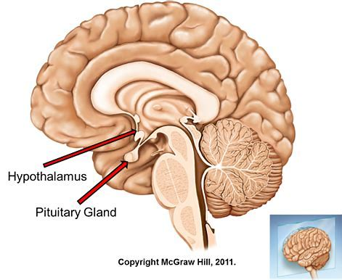
Concept Development
CFU 1
What is the role of the hypothalamus?
Hypothalamus and Pituitary Gland
The hypothalamus is a bundle of nerves that links the nervous and endocrine systems.
It monitors the body’s internal environment, i.e. temperature, metabolism, water content.
The hypothalamus secretes hormones to the pituitary gland, which then secretes more, or less, hormones itself.
The pituitary gland is often called the ‘master gland’ because it controls the activities of other endocrine glands such as the ovaries, the testes and the thyroid gland.
CFU 2
Why is the pituitary gland called the master gland?

Slide 8
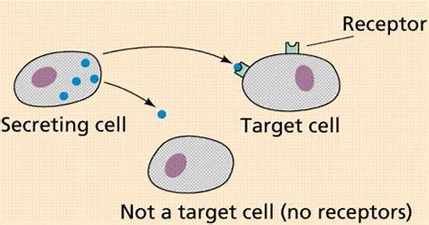
Concept Development
CFU 1
What are hormones?
Hormones
Hormones are a type of chemical messenger that work to maintain control and growth of the body.
Hormones are produced in very small amounts and travel through the blood, reaching all body cells.
However, they do not affect all the cells. Hormones are specific.
This means that they only act on particular cells in the body. These are the target cells.
CFU 2
In your own words: what are target cells?

Slide 9
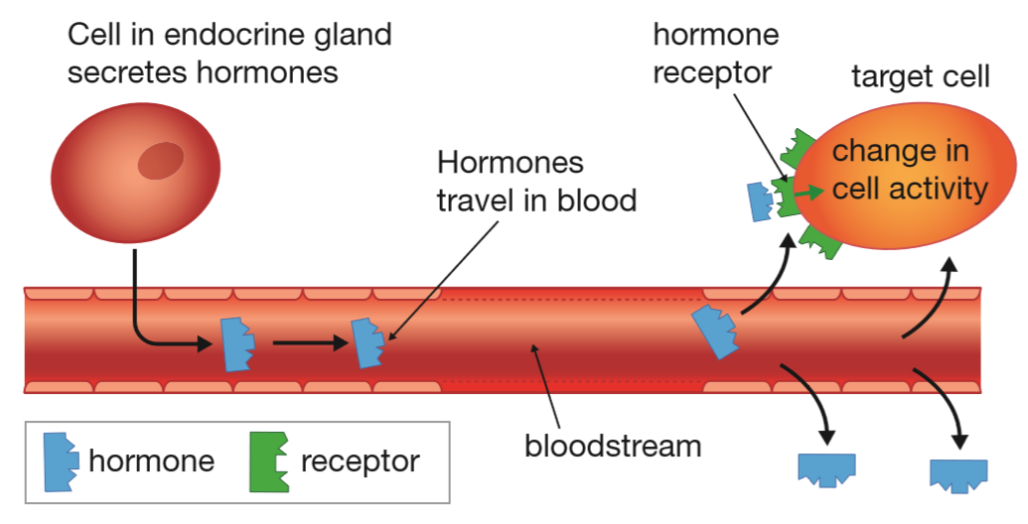
Concept Development
CFU 1
Hormones are specific because: They are fussy Their shape only fits one target cell They can change their shape to fit any cell
Target Cells
Different hormones have different chemical structures. This means that their shape varies.
It is the shape of the hormone that makes it specific.
A hormone is only active in cells that have receptors that fit the shape of the hormone.
Target cells and hormones fit together like a lock and key, or pieces of a jigsaw.
It only takes one hormone to cause a change in the target cell’s activity.

Slide 10
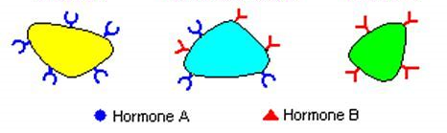
Skill Development/Guided Practice
Reminder
Hormones are specific to their target cells. They fit together like a lock and key.
Which target cell/s will Hormone A act upon? Explain your choice.

Slide 11
Skill Development/Guided Practice
Reminder
Hormones are specific to their target cells. They fit together like a lock and key.
Which target cell/s will Hormone B act upon? Explain your choice.

Slide 12
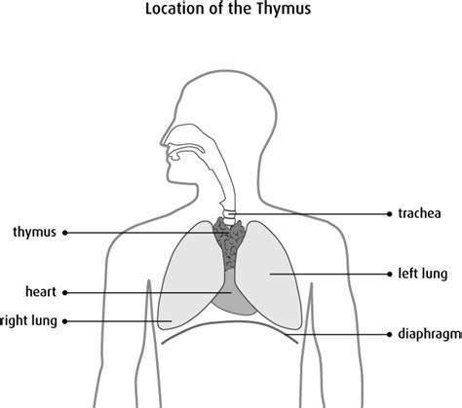
Skill Development/Guided Practice
The thymus is an endocrine organ involved in the body’s immune response.
It secretes the hormone thymosin, which helps develop white blood cells.
Locate the thymus on your Endocrine System diagram, and annotate this information.

Slide 13
Relevance
Our bodies are complex organisms that are constantly responding to changes in the external and internal environment.
Knowing about the endocrine system and helps you understand how our body maintains its optimal internal environment.

Slide 14
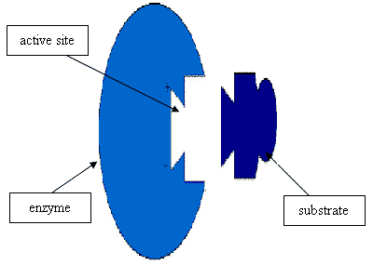
Skill Closure
What is the function of the endocrine system, and which two parts of the brain are responsible for controlling it?
Skill Closure
Draw a diagram explaining how hormones have specific target cells.
receptor
target cell
hormone

Slide 15
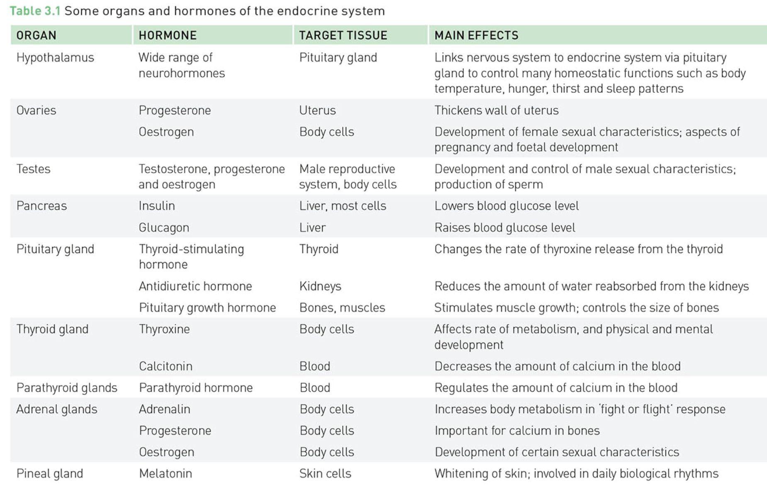
Independent Practice
Use the information below and on page 54 of the textbook to complete your endocrine system diagram.
Marigold
Rafflesia
Trumpet Vine
Cactus
Jasmine
Bottlebrush

